Slide 1
Income Prediction
By using Python and Machine Learning

Slide 2
Income prediction
Guidance :
Dhanashree Gaikwad
Minakshi Divekar
Participant:
Temgire Rushikesh Vilas
{Nowrosjee Wadia College Pune – 01}

Slide 3
Introduction
Describe the data- Specifically the predictor variables (also called independent variables features) from the Census data and the dependent variable which is the level of income (either “greater than 50k rupees or less than 50k”).
Read the data- Downloading the data directly from the source and reading it.
Explore the independent variables of the data- A very crucial step before modeling is the exploration of the independent variables.
Build the prediction model with the training data- Making prediction is not the simple thing in any organization. For that taking the particular information and making analysis is much important only after that we can predict something.
Validate the prediction model with the testing data- Here the built model is applied on test data that the model has never seen. This is performed to determine the accuracy of the model in the field when it would be deployed. Since this is a case study, only the crucial steps are retained to keep the content concise and readable.

Slide 4
Objectives :
Performance objectives
Project plan coherence
Budget prediction accuracy
Project timeline efficiency
Individual team members' task performance
2. Business objectives
Business objective when we want to align a company's values with a project for potentially higher rates of success.
3. Technical objectives
Hardware
Software
4. Quality objectives
A quality plan is a document describing my prediction standards, quality practices and the specific resources and processes needed for income prediction project.

Slide 5
Scope
This project aims to predict the income bracket of individuals based on a variety of features, and presents a holistic comparative analysis between multiple machine learning algorithms through hyperparameter optimization on a binary classification problem. machine-learning hyperparameter-optimization classification income-prediction.

Slide 6
Dataset
The dataset provided to us contains 32560 rows, and 14 different independent features. We aim to predict if a person earns more than 50k$ per year or not. Since the data predicts 2 values (>50K or <=50K), this clearly is a classification problem, and we will train the classification models to predict the desired outputs.
Details and features which we will be feeding to our classification model to train it.
1. Age — The age of an individual, this ranges from 17 to 90.
2. Workclass — The class of work to which an individual belongs.
3. Fnlwgt — The weight assigned to the combination of features (an estimate of how many people belong to this set of combination)
4. Education — Highest level of education
5. Education_num — Number of years for which education was taken

Slide 7
Dataset
6. Marital_Status — Represents the category assigned on the basis of marriage status of a person.
7. Occupation — Profession of a person
8. Relationship — Relation of the person in his family
9. Race — Origin background of a person
10. Sex — Gender of a person
11. Capital_gain — Capital gained by a person
12. Capital_loss — Loss of capital for a person
13. Hours_per_week — Number of hours for which an individual works per week
14. Native_Country — Country to which a person belongs
Output: Income — The target variable, which predicts if the income is higher or lower than 50K$.

Slide 8
Benefits
The income prediction project has been made by me to predict the income of the person . For creation of this we used the machine learning means Python, Numpy, Pandas, Seaborn, Matplotlib, Scikit-learn, etc.
Everyone is worried now a days that what kind of the job or business he should have so that he will earn the more money for the better lifestyle.
I created this project since I want to show everyone, what is there income prediction. So that they should think is their income is less or more. And according to that they should step forward.

Slide 9
Requirements :
Software :
Python
Numpy
Pandas
Matplotlib
Seaborn
Scikit-learn
Etc.
Hardware :
Processor Intel core i5
4gb Ram
SSD

Slide 10
ER diagram :
Age
workclass
Income
Prediction
Education
User
Relationship
sex
etc

Slide 11
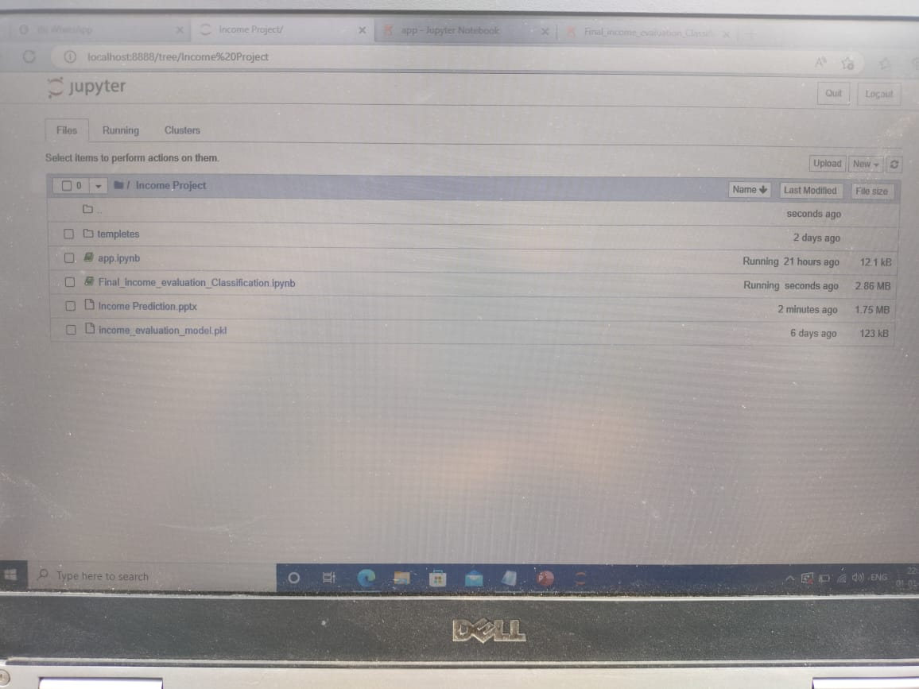
Project Overview :

Slide 12
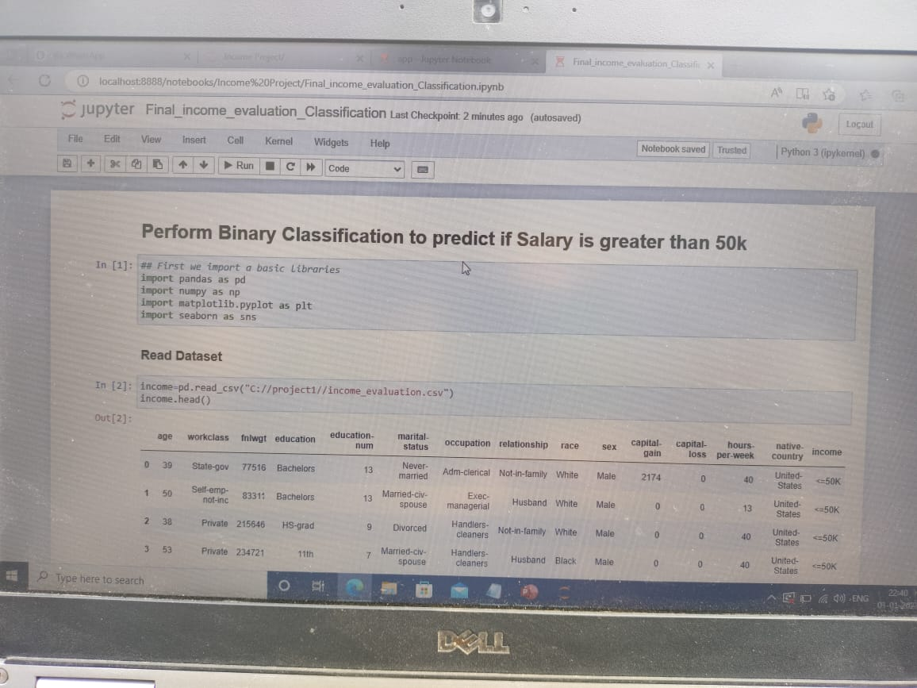
Final income evaluation file

Slide 13
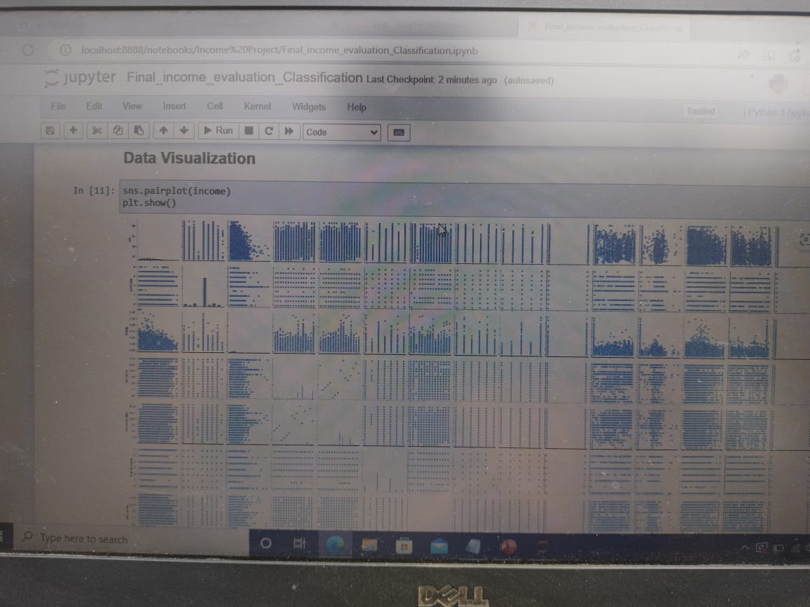
Data Visualization :

Slide 14
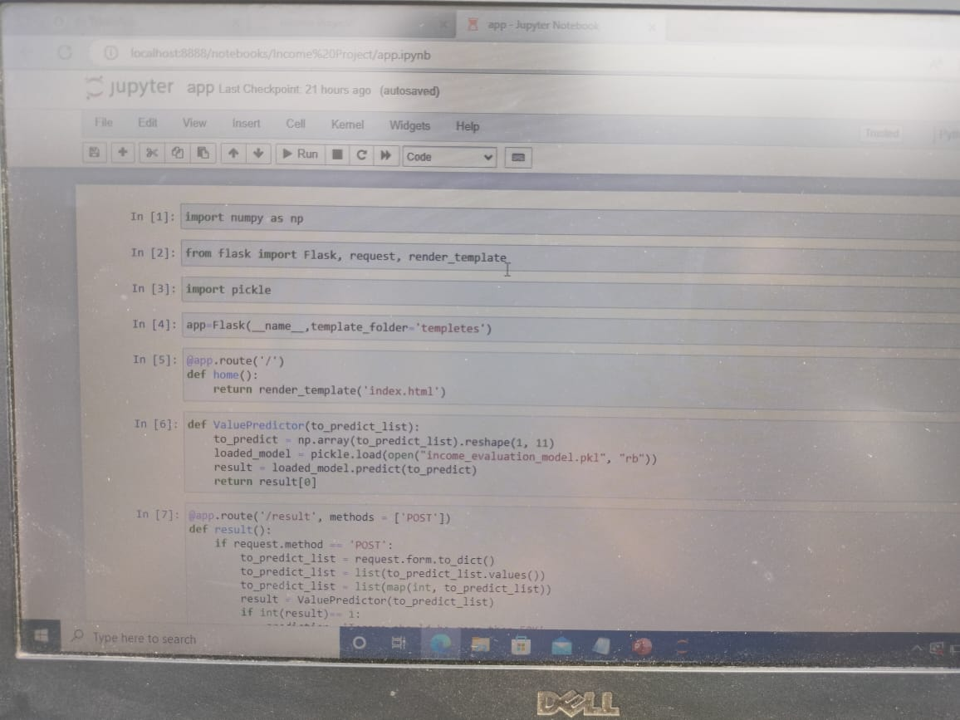
app.py

Slide 15
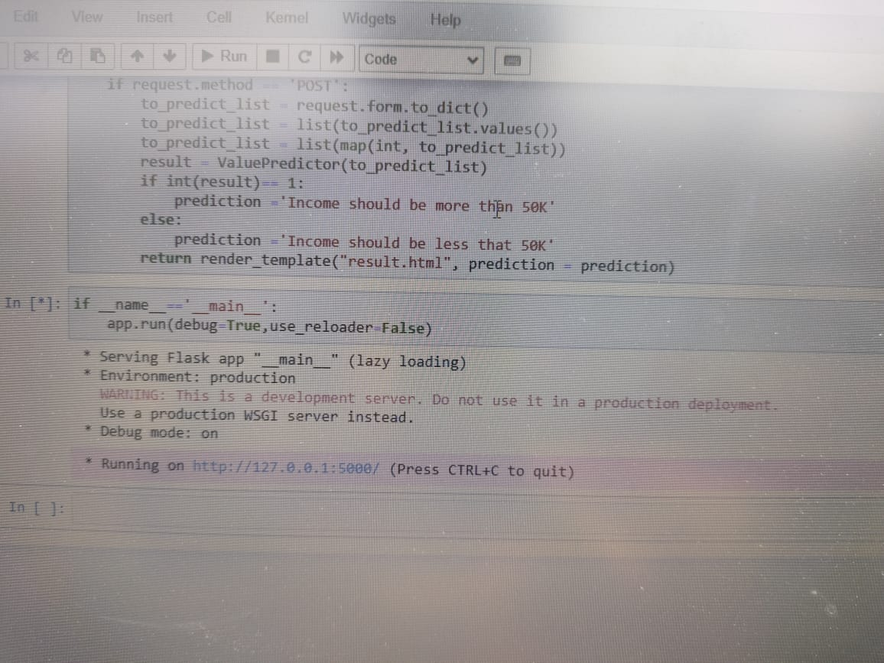
Server link :
Server

Slide 16
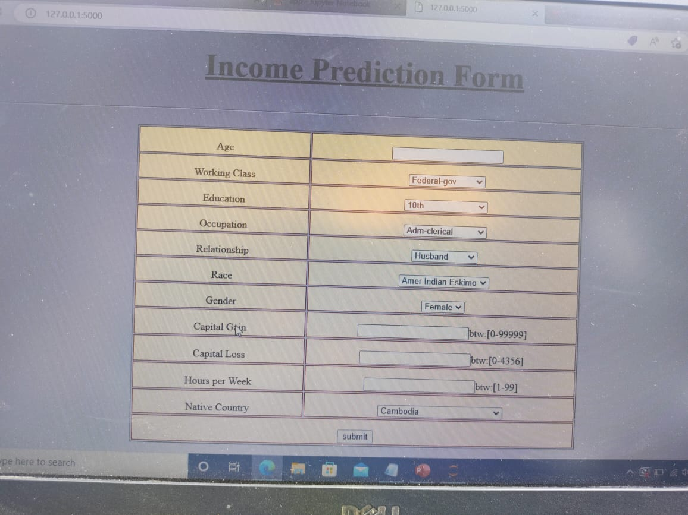
Server :

Slide 17
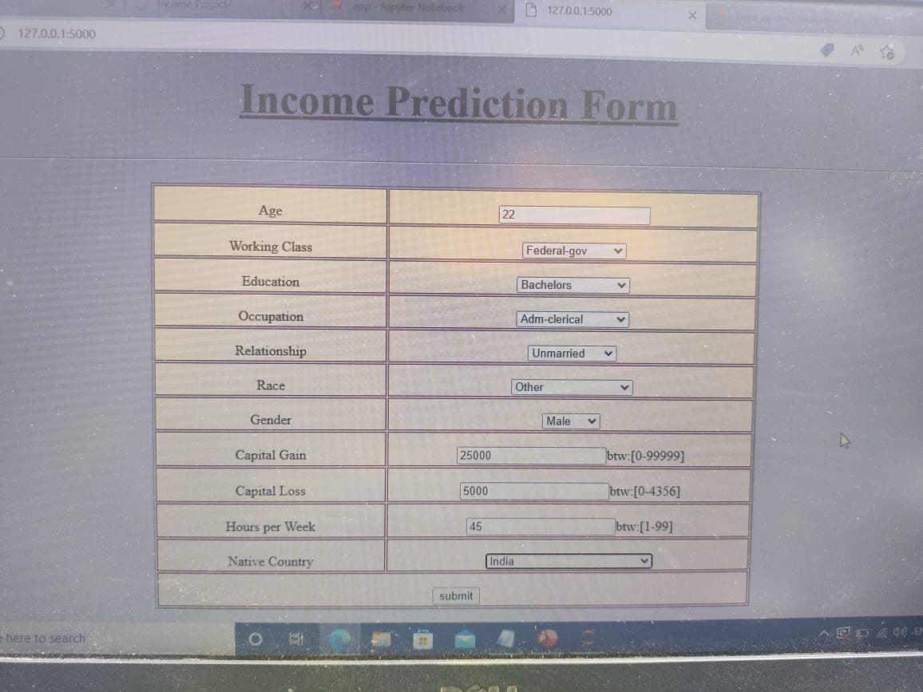
Insert values :

Slide 18
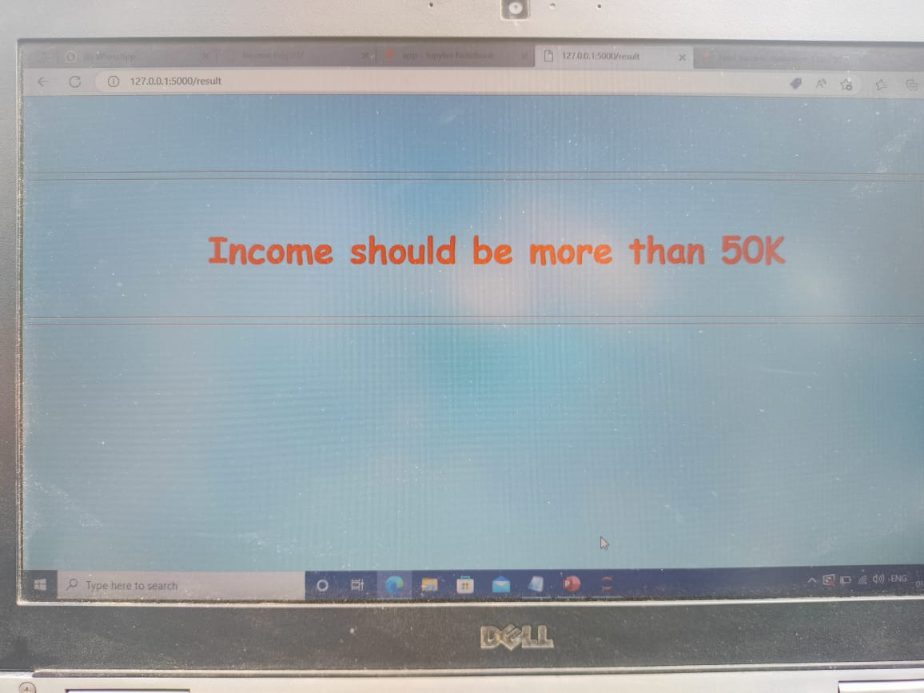
Prediction :

Slide 19
Thank You..!!

